Slide 1
What Do Defects Really Cost? More Than You Think
Wayne Ariola Chief Strategy Officer - Parasoft

Slide 2
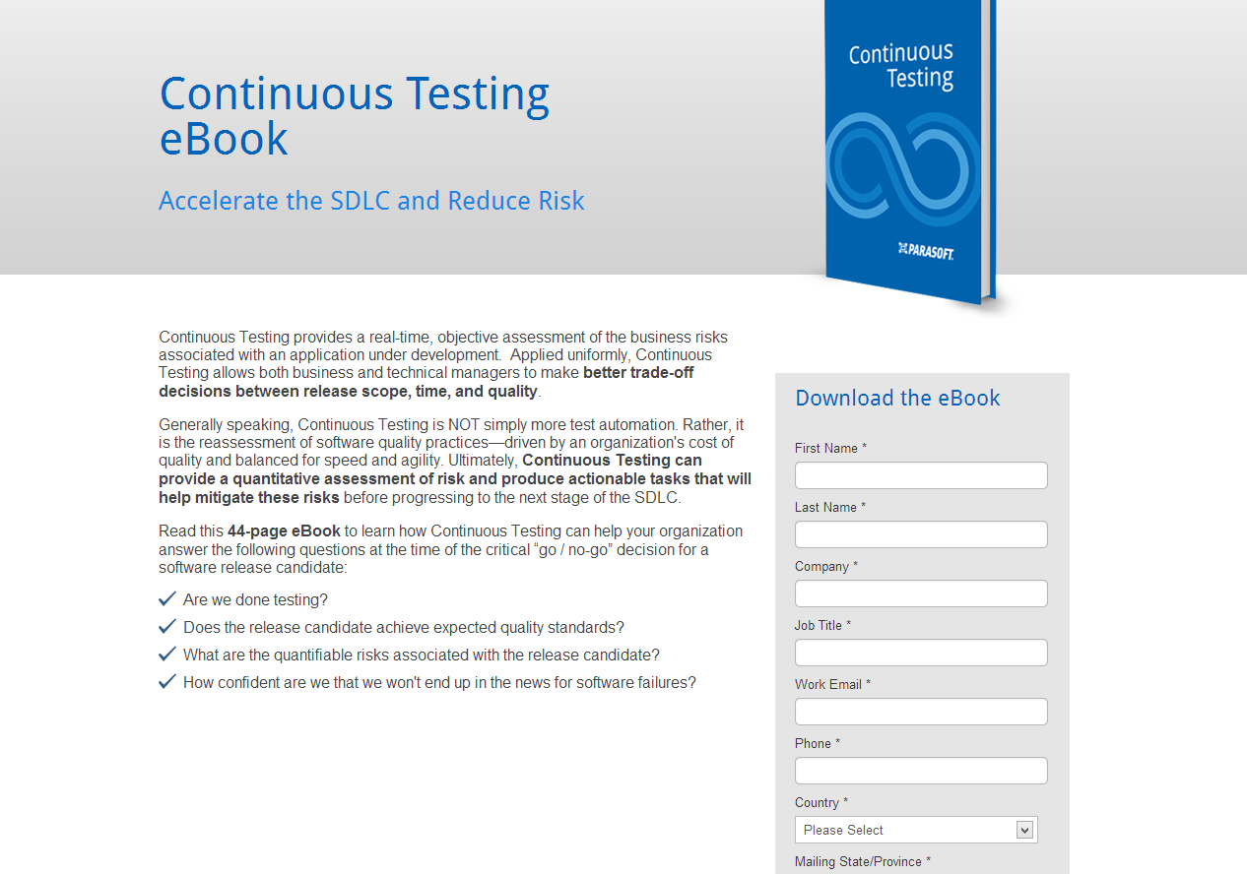
Re-Evaluate the Cost of Software Quality
http://alm.parasoft.com/continuoustestingbook

Slide 3
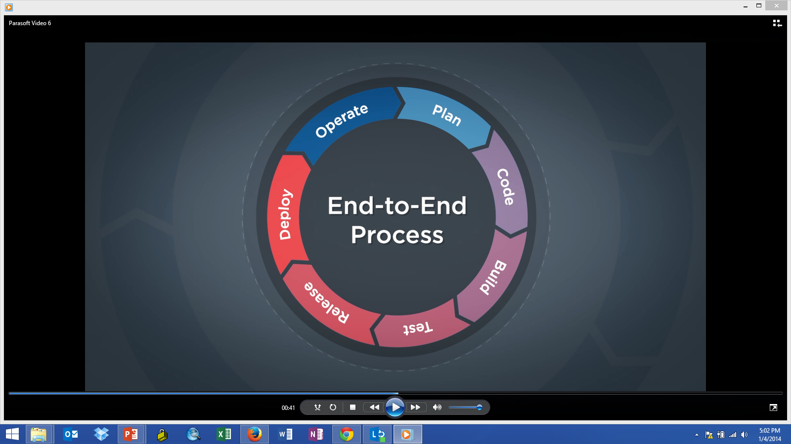


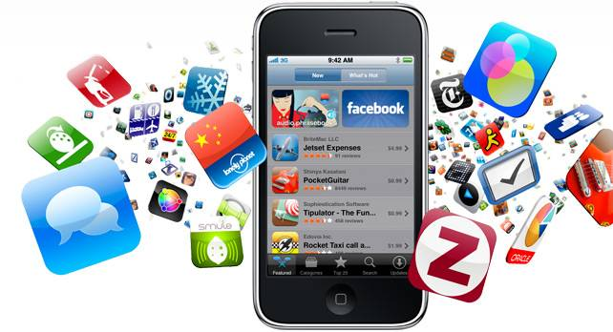
Software Drives Innovation
Software has shifted from process enabler to business differentiator
SDLC Speed will be the difference between a first mover and a follower
Switching costs associated with software are dramatically lower
The Cost of Quality associated with software has shifted dramatically

Slide 4

































Software Failures = Headlines
Financial | Airlines/Aero | Government | Media | Internet/Tel
Automotive | Technology | Retail

Slide 5
Software Failures = Headlines 2014
Software failures make headline news—
eroding customer confidence, shareholder value and brand equity
The day of the announcement companies lost an average
of shareholder value
-$2.3 Bn -3.75%
Notes:
In some recent research I analyzed the market impacts of the most notable software failures in 2012-2013.
On the day of the announcement of a software failure, organization lost an average of -2.3 Billion dollars of shareholder value. This equates to about -3.75%
Also, notable is that the markets don’t forget. Organizations that had a second offense were punished harder with an average of -5.68% decline in stock price.
With social media and news feeds on mobile devices – news outlets are ready to pounce. News articles about an organization’s second offense increase on average of 167%. The names have been obfuscated to protect the punished but here are the numbers.

Slide 6
Escalating Cost of Failure

Slide 7
Software Failures = Headlines
Punishment Increases with Second Event
Notes:
In some recent research I analyzed the market impacts of the most notable software failures in 2012-2013.
On the day of the announcement of a software failure, organization lost an average of -2.3 Billion dollars of shareholder value. This equates to about -3.75%
Also, notable is that the markets don’t forget. Organizations that had a second offense were punished harder with an average of -5.68% decline in stock price.
With social media and news feeds on mobile devices – news outlets are ready to pounce. News articles about an organization’s second offense increase on average of 167%. The names have been obfuscated to protect the punished but here are the numbers.

Slide 8
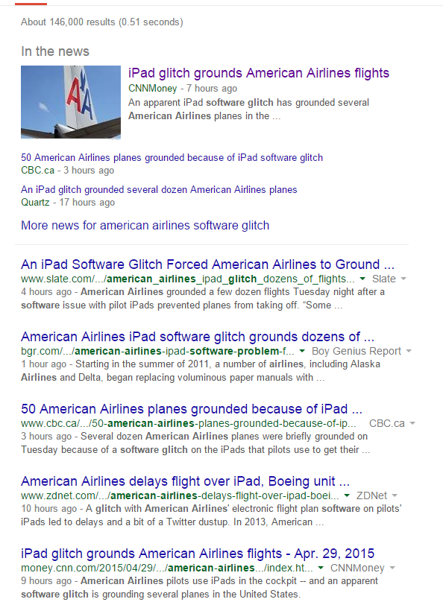
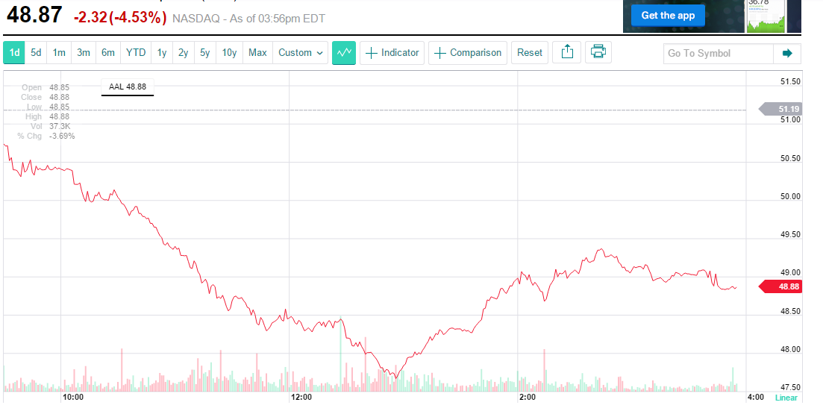
Building a stronger American - Sometimes
-5.70% -1.9B

Slide 9
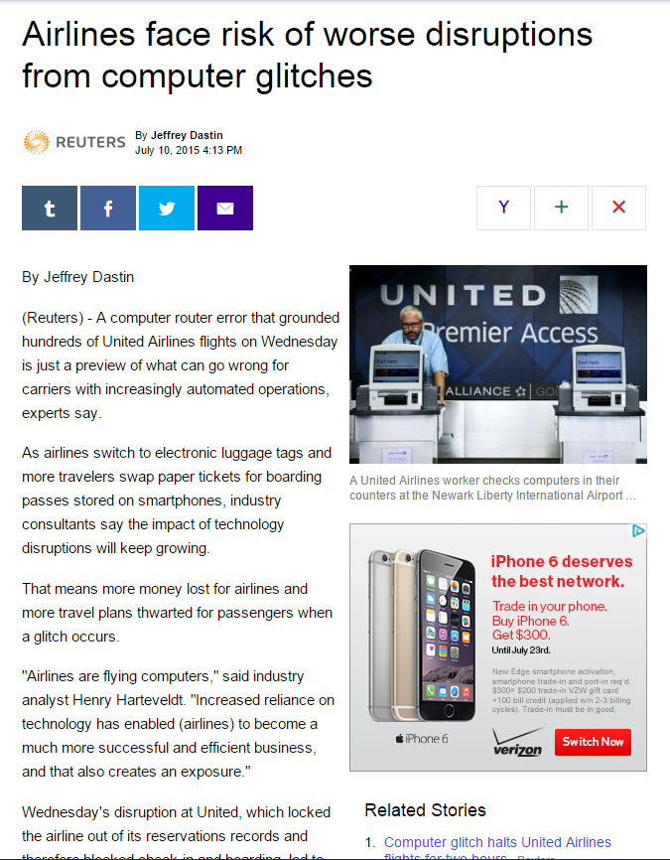
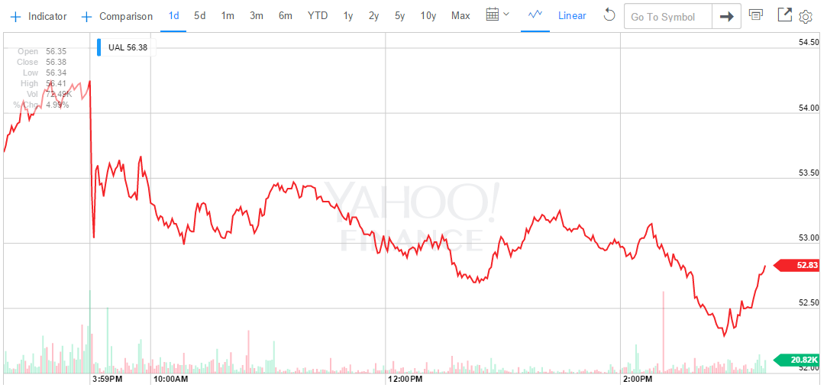
United Airlines ‘Glitch’
"Airlines are flying computers," said industry analyst Henry Harteveldt. "Increased reliance on technology has enabled (airlines) to become a much more successful and efficient business, and that also creates an exposure."
-3.61% -$750M

Slide 10
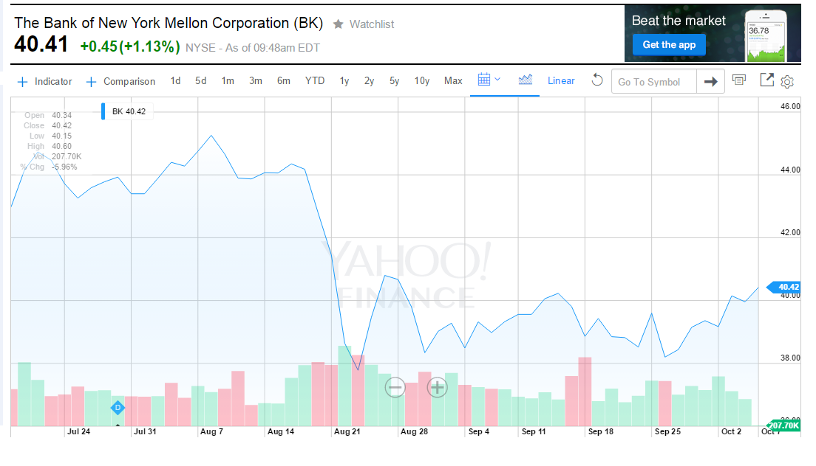
Let’s Reverse the Game…Spot the Failure
-7.4B
-15%

Slide 11
The Cost of Software Failure - Sony
Cumulative Loss = $18B
-22%
-19%
-33%
-11%
-30%
-12%
Market Value
Event
15 Days
30 Days
http://www.reuters.com/article/2011/04/26/us-sony-stoldendata-idUSTRE73P6WB20110426
http://www.digitaltrends.com/gaming/sony-fined-almost-400000-for-2011-playstation-security-breach/

Slide 12
Testing is a Bottleneck
Organic Systems
Software Quality Processes
Business Views
Fully Automated Provisioning
Data Analytics
Efficiency
End-to-End Tasks
Process Oriented
Skilled Tasks
Basic Tasks
Automation is Incremental

Slide 13

From Automated to Continuous Testing

Slide 14
Impact of Test in the Evolving SDLC
Test as a time-boxed event is the prevailing method
Plan
Develop
Build
Test
Release
Fixed
Fixed
“Are we done testing?”

Slide 15
Impact of Test in the Evolving SDLC
Plan
Develop
Release
Build
Build
Build
Build
Build
Build
Build
Build
Build
Build
Build
Test
Test
Test
Test
Test
Test
Test
Test
Test
Test
Test
“Does the release candidate have an acceptable level of risk?”

Slide 16
2015 Non-Functional Requirements Survey
OF 2580 Respondents What best describes your role in your organization?

Slide 17
2015 Non-Functional Requirements Survey
Does your organization measure or monitor compliance to NON-functional requirements?

Slide 18
2015 Non-Functional Requirements Survey
‘Yes,’ My Organization Monitors Compliance to NON-Functional Requirements (NFRs)

Slide 19
Next Generation Testing
Exploratory
Ops Data
Validation
Continuous Regression Suite
Process Intelligence
Integration
Verification
Automated Acceptance Testing
Requirements

Slide 20
Getting from “Automated” to “Continuous”
There is a big leap moving from “Automated” to “Continuous”
Business expectations clearly defined
Business risks identified
Per application, team, release
Defects automatically prioritized versus business drivers
No defect left behind
Mitigate business risks
Testing in ‘complete’ test environments continuously
Leveraging simulation – Service Virtualization
Protecting the user experience “top-down”
Feedback loop for defect prevention
Pattern definition
Defect prevention practices enhanced

Slide 21
Service Virtualization
Service Virtualization delivers a simulated test environment to help development and testers with earlier, faster and more complete testing

Slide 22






So, What are you Virtualizing?
AUT
Mainframe
SOA / Web services
Java
.NET languages
XML
WSDL
WADL
UDDI
WSIL
SOAP
PoX (Plain XML)
REST
JSON
BPEL
Web Applications
Mobile Interfaces
AJAX
JSP
JavaScript
HTML
CSS
WS-*
Standards
MTOM(XOP) / MIME / DIME
OAuth
TCP/IP
webMethods Broker
webMethods IS
HL7
FTP
HTTP 1.0
HTTP 1.1
HTTPS
JMS
IBM WebSphere MQ
Sonic MQ
RMI
EJB
SMTP
Tibco Rendezvous
.NET WCF
ISO 8583
EDI
SAP
custom

Slide 23

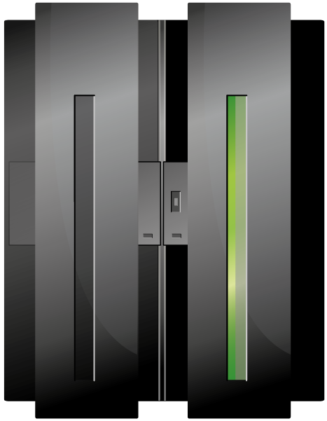


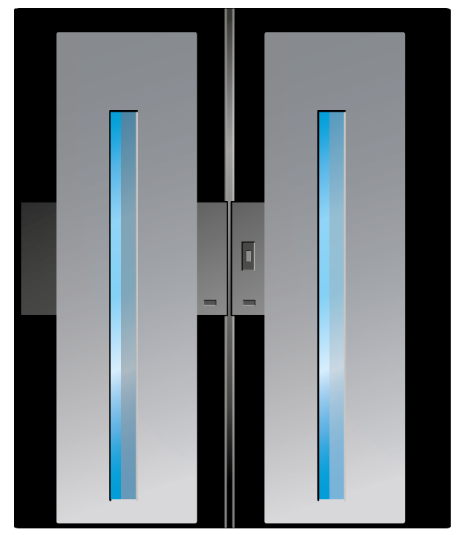




Access to Dev / Test Systems
Complex
Mainframe
External Database
Cloud App
ERP
Message Queue
External Application
Configuration
Web Server
Internal Database
ESB
Internal Application
3rd Party Service
Internal Service
Simple
Difficult
Test Access

Slide 24
Service Virtualization & Dependencies
Access
Dependent applications difficult
Scheduling conflicts
High access fees
Geo-political boundaries
3rd party or partner applications
Configuration
Complex to configure
No control
Limited variability
Consumes test time
Complex
Service Virtualization
Virtual Lab / Server Virtualization
Configuration
Easy
Simple
Difficult
Access

Slide 25
The Total Cost of System Access
Service Virtualization dramatically reduces the cost of delivering a dev / test environment
Only manage the functionality you need
Only manage data you need
Low-Risk “disposable instance” that can be accessed at anytime
Dramatically reduce test environment setup and management
Cost
Staged Application Instance
Hardware Savings
Access Efficiency
Staged w/ Virtual Test Lab
Service Virtualization
System Behavior

Slide 26
Parasoft Service Virtualization
Questions?
Wayne Ariola
Chief Strategy Officer
Parasoft Corporation
Wayne.ariola@Parasoft.com

